Slide 1

Call coverage for
[CLIENT BUSINESS]
Virtual receptionist and simple
customer workspace
[YOUR NAME]
[YOUR BUSINESS]
I may earn a commission if you sign up for Handled Calls through my referral.
Notes:
Replace [CLIENT BUSINESS], [YOUR NAME], [YOUR BUSINESS] and [PARTNER CODE] before sharing. Keep the disclosure visible. This presentation does not claim that the presenter uses the product. Product and pricing sources: https://www.handledcalls.com/ and https://www.handledcalls.com/frequently-asked-questions . Photo: Kathleen Austin Kuhn, https://www.pexels.com/photo/technician-inspecting-outdoor-hvac-unit-32497161/ .

Slide 2
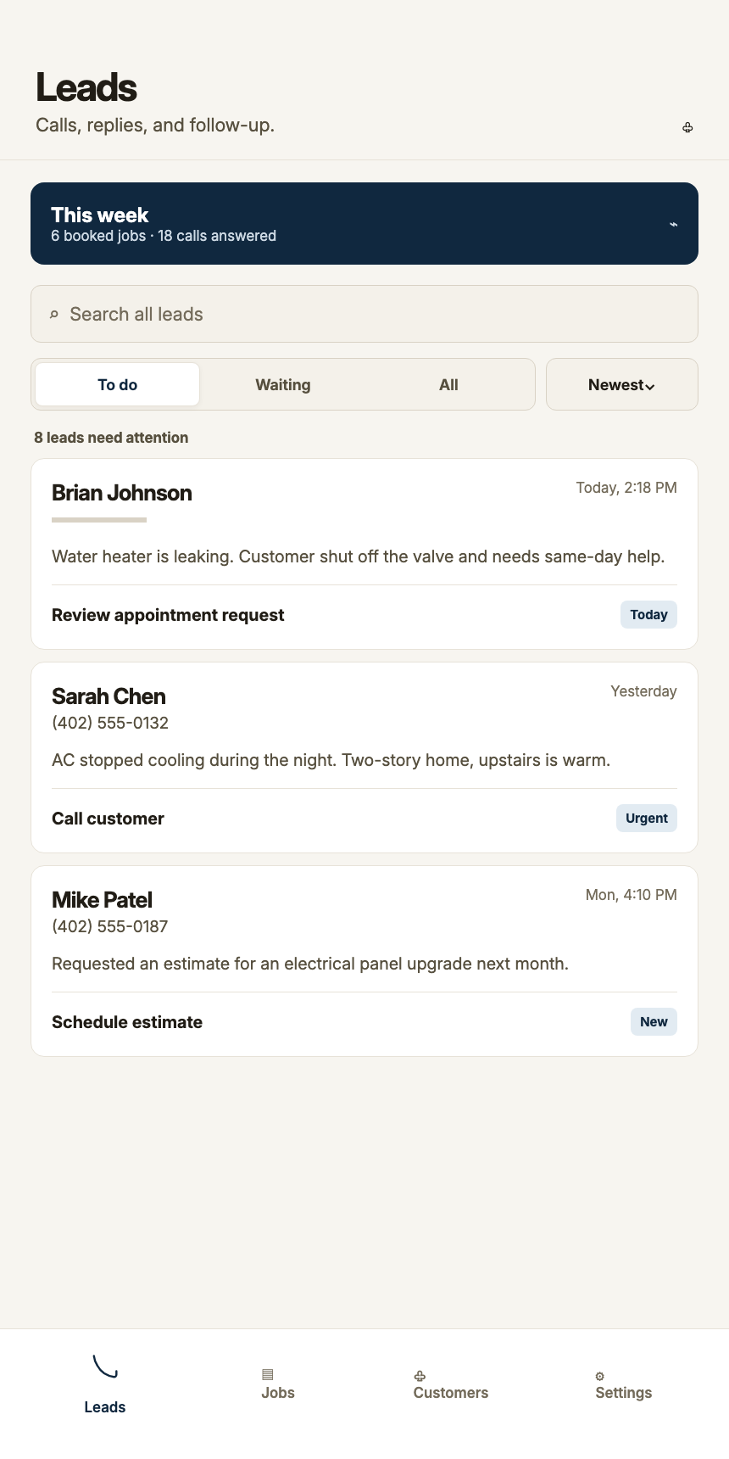
When a new call arrives
1 Give the caller a response
The virtual receptionist answers missed and after-hours calls when your forwarding is active.
2 Collect the request
Capture what the caller needs, where the work is, and the details your team will use.
3 Choose the next step
Review the lead, contact the customer or schedule work.
Sample data
Notes:
Explain the workflow, then ask when this client misses calls. Do not promise a booked job or a revenue result. Product source: https://www.handledcalls.com/frequently-asked-questions . The screenshot is first-party demonstration data.

Slide 3
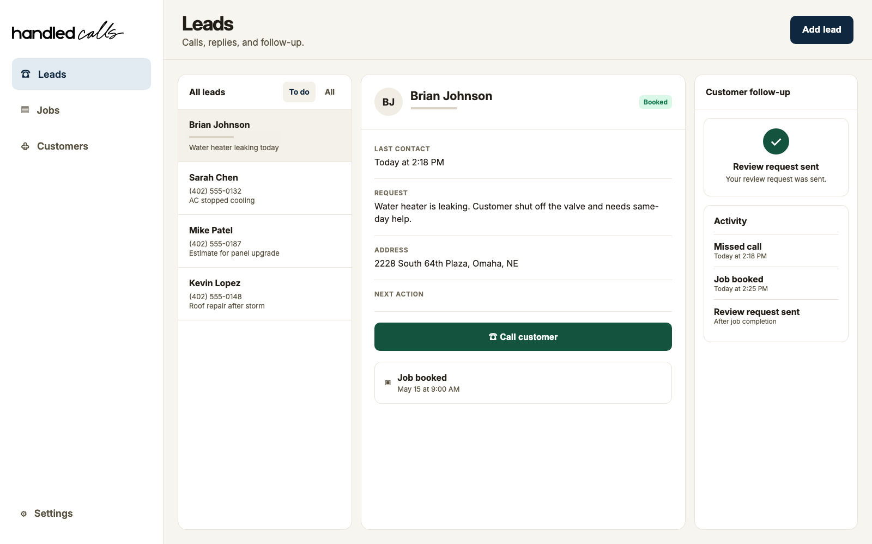
The details in one place
Review the request and choose a useful next step.
Example workspace with sample data
Notes:
Show the request, contact information and next action in the example. Records vary by the call and provider; recordings and transcripts appear when available. The screenshot contains demonstration data, not a real customer result. Source: https://www.handledcalls.com/#product .

Slide 4
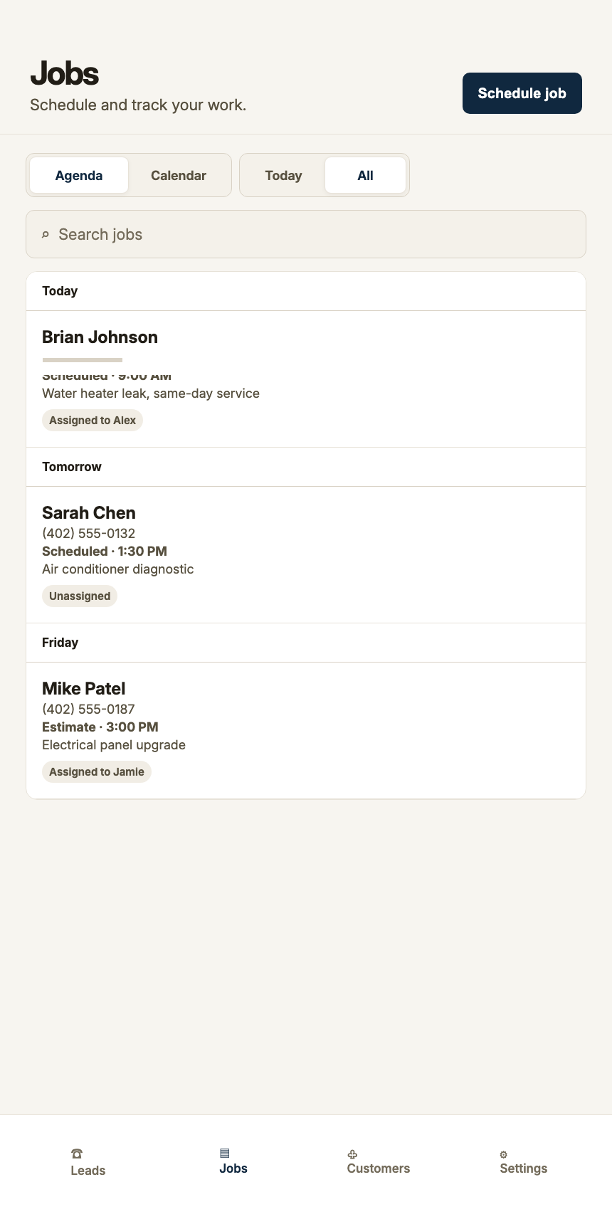
Booking that follows your settings
Offer eligible appointment times
With instant voice booking enabled, the receptionist can create a job after the caller chooses a time that fits your saved availability.
Review requests when needed
When instant booking is off or the request does not fit, your team reviews it. Website appointment requests also wait for owner approval.
Availability lives in Handled Calls. External calendar sync is not currently supported.
Notes:
Confirm the services, job lengths, hours, notice windows, time off and team availability the business needs. Instant voice booking is optional and requires eligible saved availability. Website appointment requests wait for owner approval. External calendar sync is not currently supported. Source: https://www.handledcalls.com/frequently-asked-questions .

Slide 5
Keep your number and get setup help
Complete your business setup
Add your services, service area, hours and booking preferences.
Start the 14-day trial
A card is required at trial checkout. The team then contacts you within one business day.
Get guided activation
Calls reach the receptionist after activation and call forwarding are complete.
Notes:
Most businesses keep their existing customer-facing number and carrier through forwarding. Do not describe account creation as immediate live call coverage. Calls begin only after activation and forwarding. Sources: https://www.handledcalls.com/frequently-asked-questions . Photo: Rene Terp, https://www.pexels.com/photo/smiling-man-in-workwear-holding-tools-13821194/ .

Slide 6
Pricing
$89
$1.89 per Verified Call
A completed conversation with a real customer.
every 28 days
One user included
$29 per additional user
Each 28-day cycle
14 days free, including Verified Calls
Card required. Renews automatically unless canceled before trial ends.
Fair-use terms apply. Current pricing: handledcalls.com/#pricing
Notes:
Pricing verified against the September 20 website. All amounts are USD. Additional users and base subscription are paid in advance; paid-cycle Verified Call usage is billed after the cycle. Legitimate service questions or follow-ups can count even when no job is booked. No commission or income promise is part of this client presentation. Sources: https://www.handledcalls.com/#pricing and https://www.handledcalls.com/terms-and-conditions/ .

Slide 7
Hear the demo and ask your questions
Recorded test call
handledcalls.com/#demo
A walkthrough with the team
handledcalls.com/book-a-demo/
Enter this assigned partner code during signup
[PARTNER CODE]
Questions? hello@handledcalls.com
Notes:
Replace [PARTNER CODE] with your assigned code. Code entry at signup is reviewed; do not imply that a link alone tracks attribution. The full recording is a 1:58 test call with a human caller and the virtual receptionist, not a customer result. Wording and availability vary by business. Eligible code customers may receive 20% off their first paid base cycle only after review; see partner terms. Sources: https://www.handledcalls.com/#demo and https://www.handledcalls.com/partner-program-terms/ .

